Slide 1
Object Oriented Concepts & Principles

Slide 2
Object Oriented Paradigm
(Paradigm: a way of seeing and doing things)
Object - Oriented (OO) Programming:
Organizing software as a collection of objects with a certain state and behavior.
Object Oriented Design:
Based on the identification & organization of objects.
OO Modeling
Modeling objects based on the real world

Slide 3
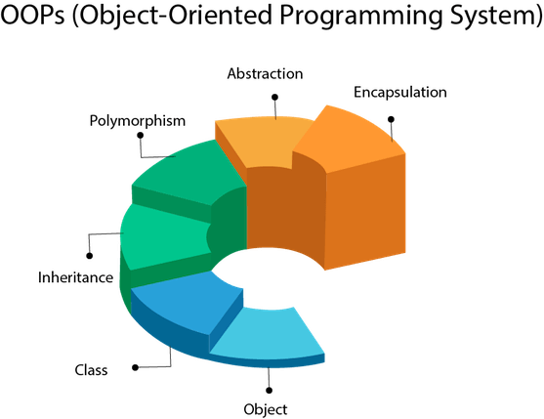

Slide 4
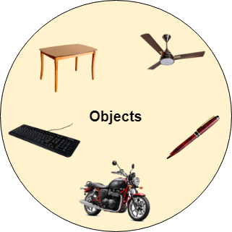

Slide 5
Objects
Any entity that has state and behavior is known as an object. For example a chair, pen, table, keyboard, bike, etc. It can be physical or logical.
Example: A dog is an object because it has states like color, name, breed, etc. as well as behaviors like wagging the tail, barking, eating, etc.
Object - instance of a class.
Object contains an address and memory.

Slide 6
Java Objects
Object: Data type that has an identity, contains other data types called attributes and modules of code called operations or methods
Attributes and associated values are hidden inside the object.
Any object that wants to obtain or change a value associated with other object, must do so by sending a message to one of the objects (invoking a method)

Slide 7
Example
methods (methods)
Object: woman
Attributes (values)
method:
Set_salary
Age: 35
Salary: 10
Set_salary (20)
Get_age
employer
friend

Slide 8
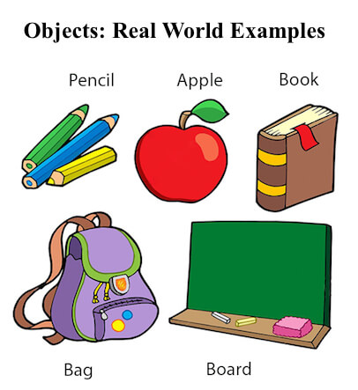

Slide 9
Creating an Object
There are three steps when creating an object from a class −
Declaration − A variable declaration with a variable name with an object type.
Instantiation − The 'new' keyword is used to create the object.
Initialization − The 'new' keyword is followed by a call to a constructor. This call initializes the new object.

Slide 10
Class
Collection of objects is called class. It is a logical entity.
A class can also be defined as a blueprint from which you can create an individual object. Class doesn't consume any space.
Classes are templates that have methods and attribute names and type information, but no actual values!
Objects are generated by these classes and they actually contain values.

Slide 11
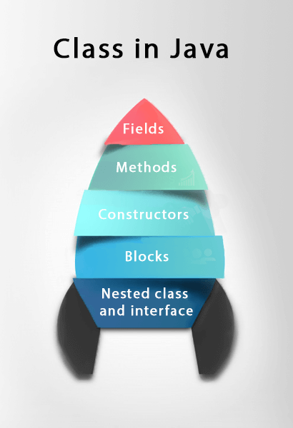


Slide 12
Class & Objects
CLASS: Furniture
Name
methods: Example
ChangeNumber
Number
Objects:
Desk
ChairA
ChairB
123445
32143
45687

Slide 13
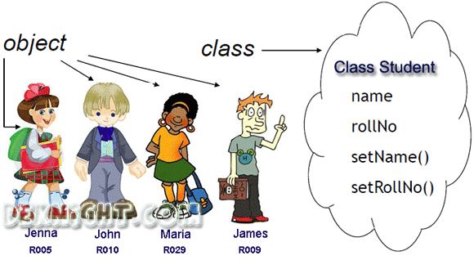
The new keyword is used to allocate memory at runtime. All objects get memory in Heap memory area.

Slide 14
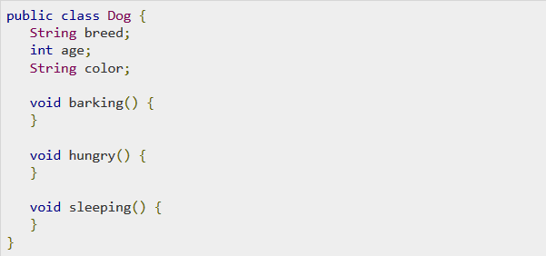
class

Slide 15
Advantages
Advantage of having interface independent of object representation or implementation of operations:
Program organization
modifiability (everything associated with a data structure is together)
separate compilation

Slide 16
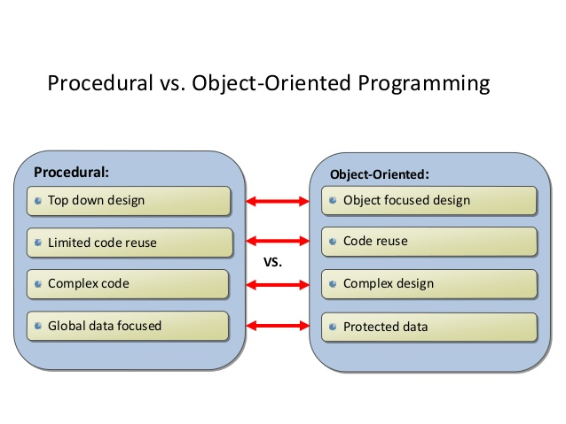

Slide 17
Message Passing & Associations
Methods are associated with classes but classes don’t send messages to each other.
Objects send messages.
An association between two classes means that the objects of the two classes can send messages to each other.
Aggregation: when an object contains other objects ( a part-whole relationship)

Slide 18
Encapsulation
Each objects methods manage it’s own attributes (hiding)
An object A can learn about the values of attributes of another object B, only by invoking the corresponding method (message) associated to the object B.
Idea is to hide the implementation details from users. If a data member is private it means it can only be accessed within the same class.
No outside class can access private data member (variable) of other class.

Slide 19
Inheritance
The process by which one class acquires the properties(data members) and functionalities(methods) of another class is called inheritance.
The aim is to provide the reusability of code so that a class has to write only the unique features and rest of the common properties and functionalities can be extended from the another class.
Child Class: The class that extends the features of another class is known as child class, sub class or derived class.
Parent Class: The class whose properties and functionalities are used(inherited) by another class is known as parent class, super class or Base class.

Slide 20
Class Inheritance & Specialization
Class: Furniture
Attribute A1
Method A1
Class name
Attributes
Methods
Class: Chairs
[Attribute A1]
Attribute B1
[Method A1]
Method B1
Is a specialization of
Or
Inherits from
Class: Executive Chairs
[Attribute A1]
[Attribute B1]
Attribute C1
[Method A1]
Method B1 (B1 code modified)
Method C1

Slide 21
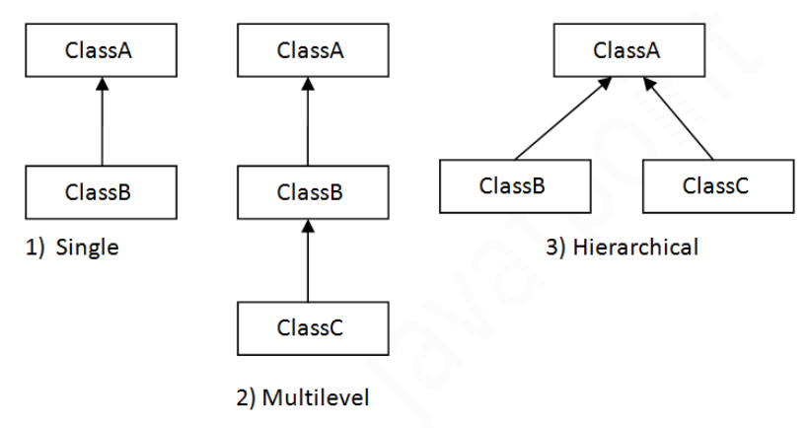
Types of Inheritance
Note: Multiple inheritance is not supported in java through class.

Slide 22
Class Hierarchies & Inheritance
Classes can be arranged in hierarchies so that more classes inherit attributes and methods from more abstract classes
Class hierarchy diagrams
Class: Chair
subclasses
Chair Type A
Chair Type B

Slide 23
class XYZ extends ABC
{
}

Slide 24
variables
Local variables − Variables defined inside methods, constructors or blocks are called local variables. The variable will be declared and initialized within the method and the variable will be destroyed when the method has completed.
Instance variables − Instance variables are variables within a class but outside any method. These variables are initialized when the class is instantiated. Instance variables can be accessed from inside any method, constructor or blocks of that particular class.
Class variables − Class variables are variables declared within a class, outside any method, with the static keyword.

Slide 25
Polymorphism
Means that the same method will behave differently when it is applied to the objects of different classes
It also means that different methods associated with different classes can interpret the same message in different ways.
Example: an object can send a message PRINT to several objects, and each one will use it’s own PRINT method to execute the message.

Slide 26
constructors
Every class has a constructor. If we do not explicitly write a constructor for a class, the Java compiler builds a default constructor for that class.
Each time a new object is created, at least one constructor will be invoked. The main rule of constructors is that they should have the same name as the class. A class can have more than one constructor.

Slide 27
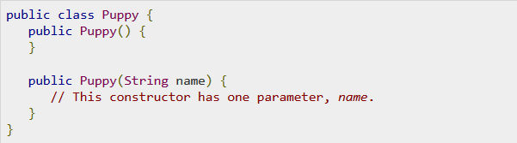

Slide 28
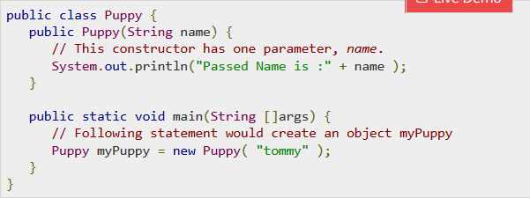

Slide 29
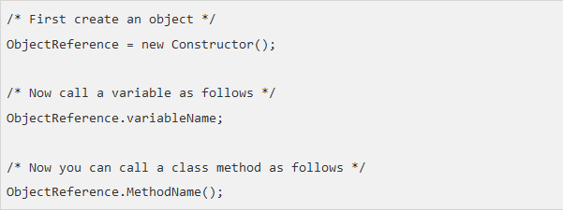
Accessing Instance Variables and Methods

Slide 30
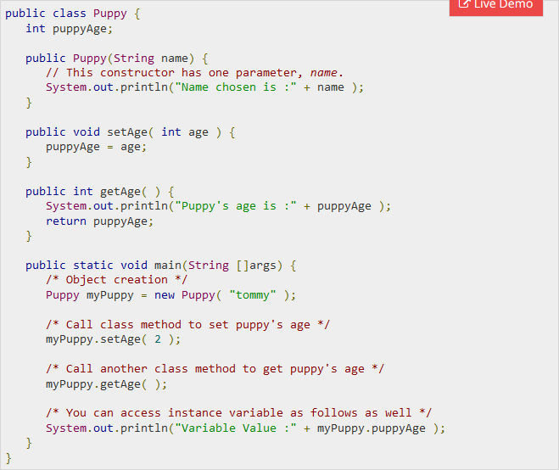

Slide 31
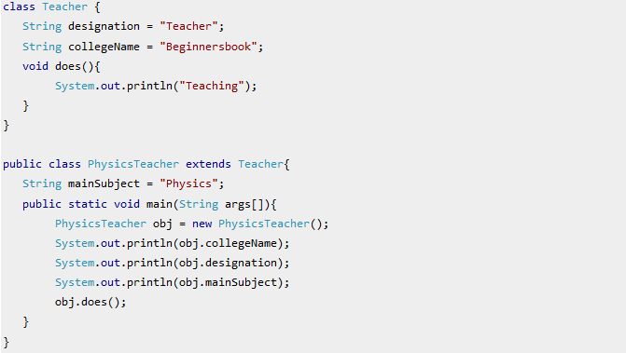

Slide 32
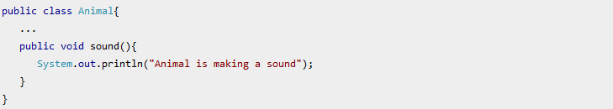

Slide 33
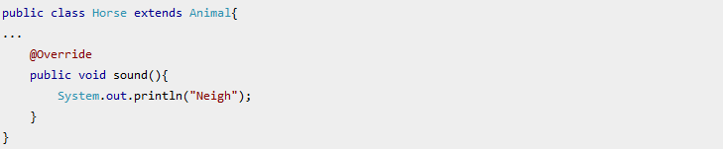
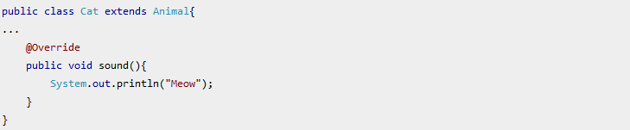

Slide 34
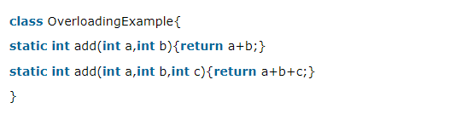
Method Overloading

Slide 35
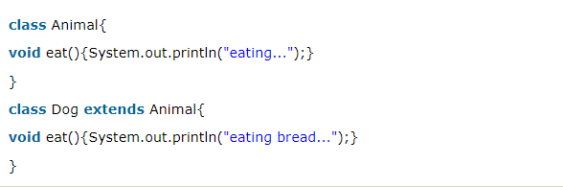
Method Over Riding

Slide 36
Polymorphism
A person at the same time can have different characteristics. Like a man at the same time is a father, a husband, an employee. So the same person possesses different behavior in different situations. This is called polymorphism. Polymorphism is considered one of the important features of Object-Oriented Programming.
Polymorphism allows us to perform a single action in different ways. In other words, polymorphism allows you to define one interface and have multiple implementations. The word “poly” means many and “morphs” means forms, So it means many forms.

Slide 37
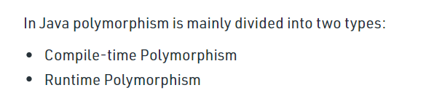
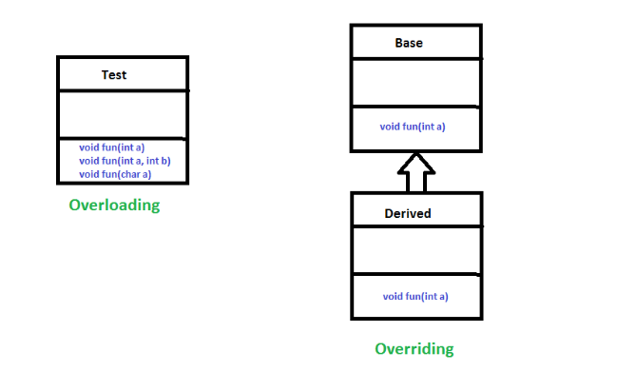

Slide 38
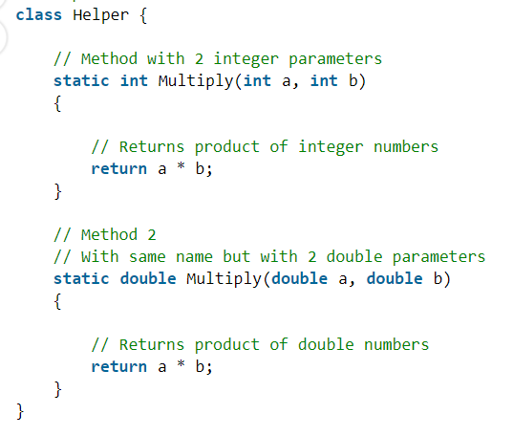
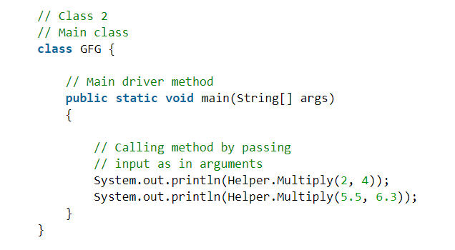

Slide 39
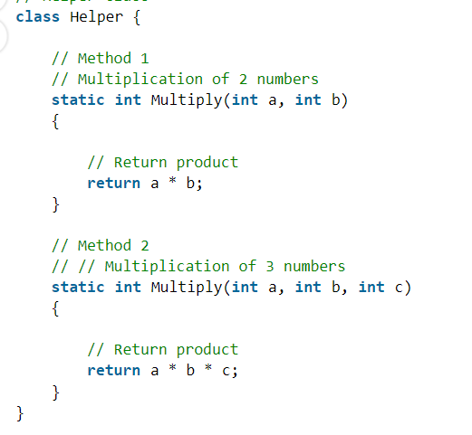
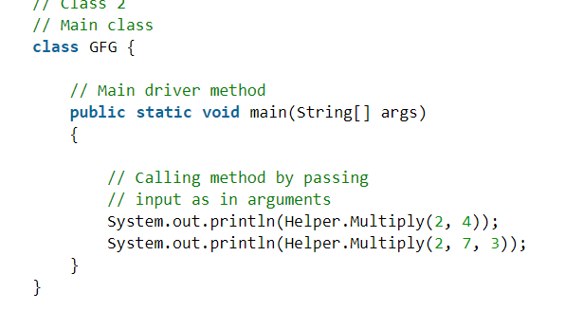

Slide 40
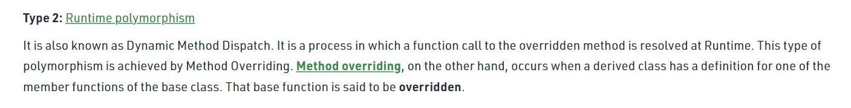
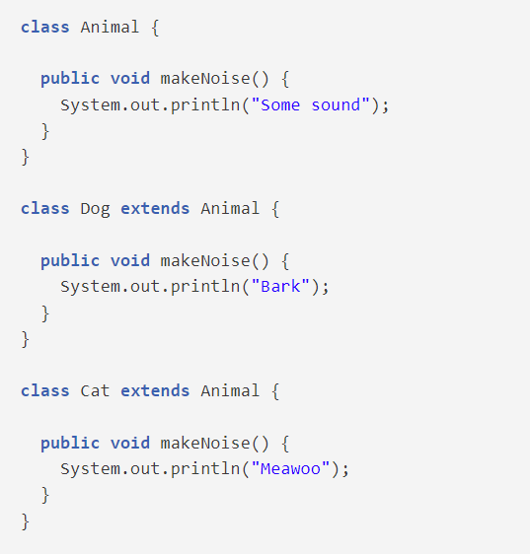
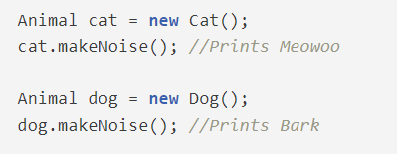

Slide 41
Static
The static keyword in Java is used for memory management mainly. We can apply static keyword with variables, methods, blocks and nested classes. The static keyword belongs to the class than an instance of the class.
The static can be:
Variable (also known as a class variable)
Method (also known as a class method)
Block
Nested class

Slide 42
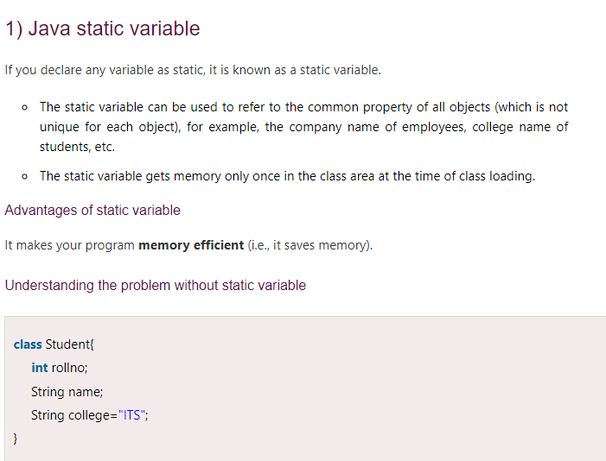

Slide 43
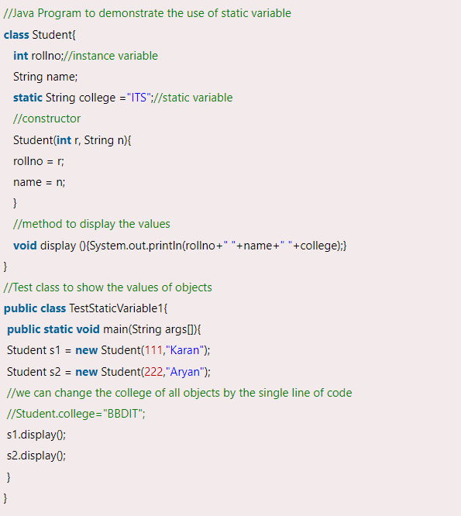

Slide 44
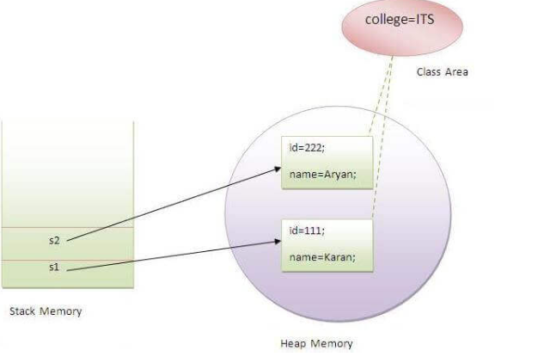

Slide 45
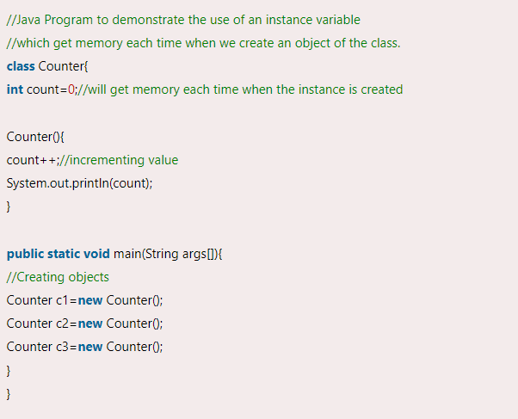
Without static

Slide 46
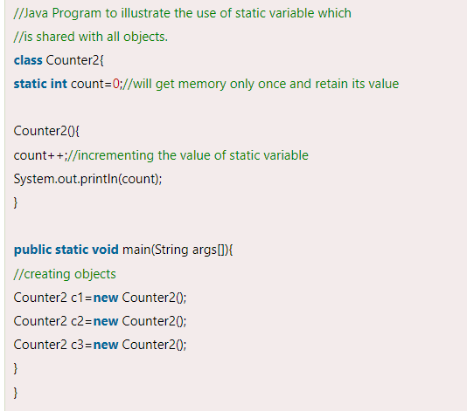

Slide 47
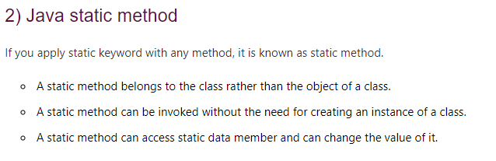

Slide 48
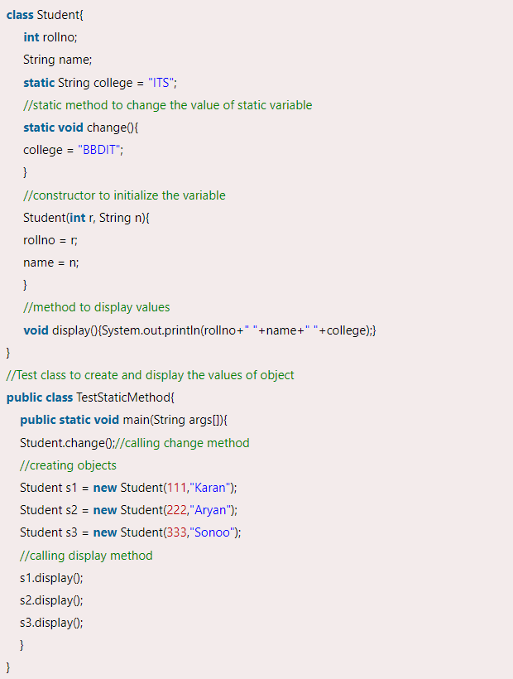
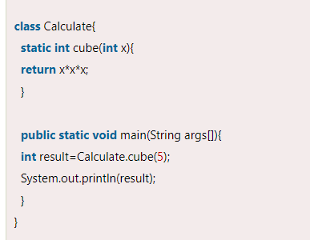

Slide 49
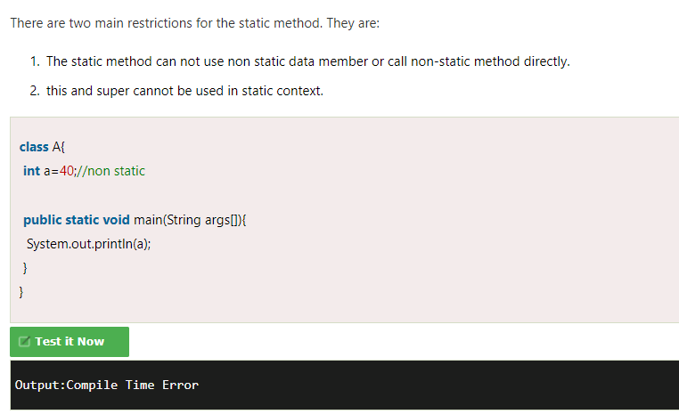

Slide 50
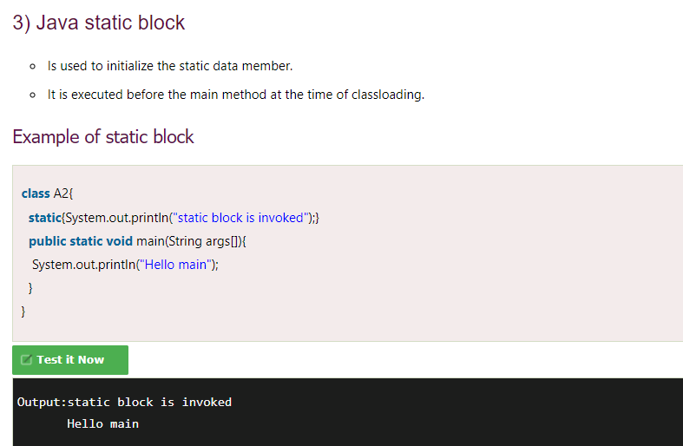

Slide 51
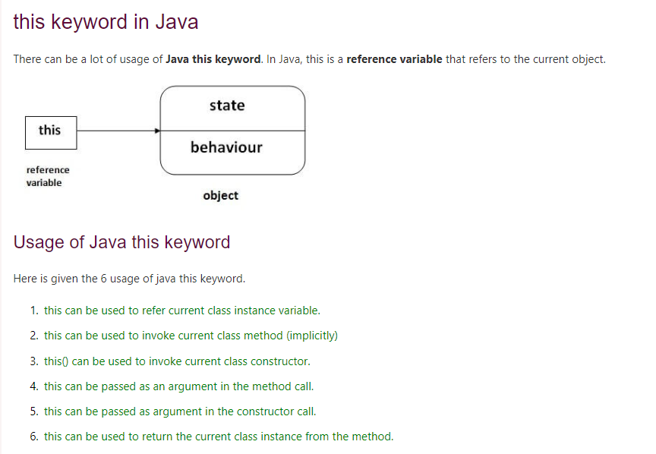

Slide 52
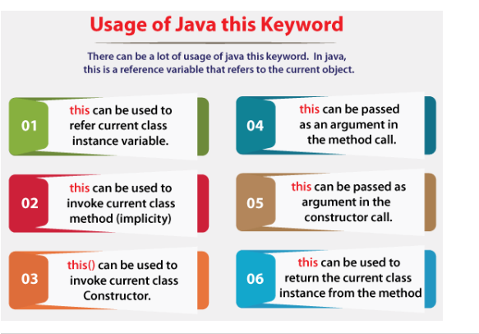

Slide 53
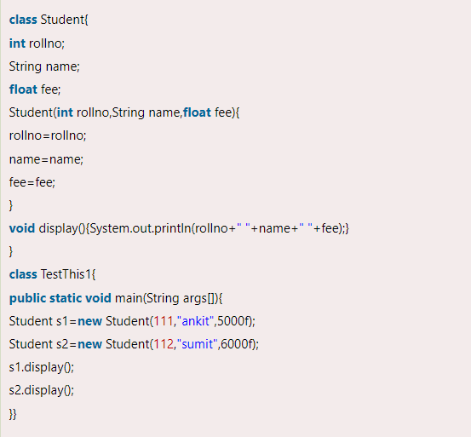

Slide 54
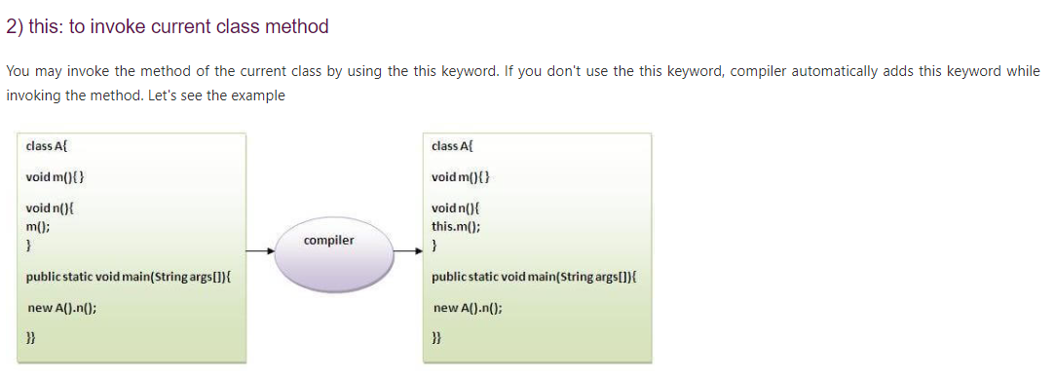
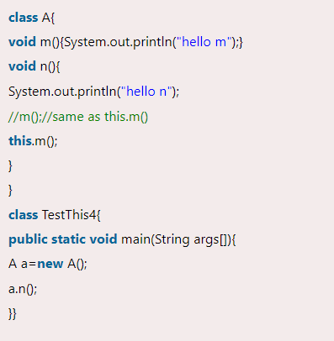

Slide 55
